Slide 1
DOE Energy I-Corps Team 92: EcoBlock Technology
“Unlocking the Potential Eco-Makeover of Urban Residential Neighborhoods”
PI: Rich Brown
Building Technologies & Urban Systems, LBNL
EL: Tony Nahas
CIEE, UC Berkeley
IM: Greg Wolfson
Shell New Energies
Interviews:
Total completed: 75; In-person: 44; Video: 3; Phone: 28

Slide 2
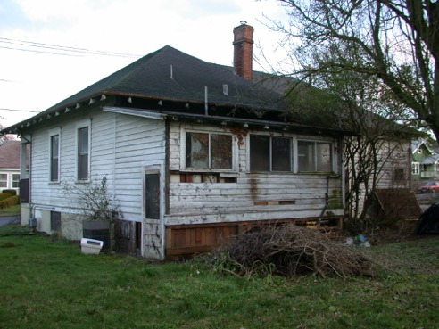
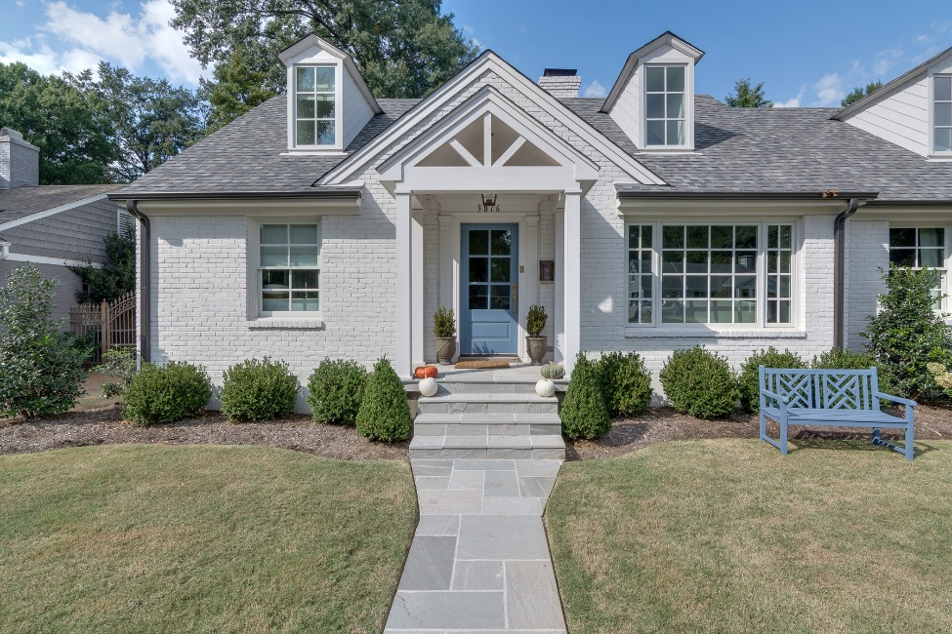
Value Proposition
Hey Honey, what if we could channel big savings from our monthly utility, gasoline & auto bills into renovating our house and beautifying our block?

Slide 3
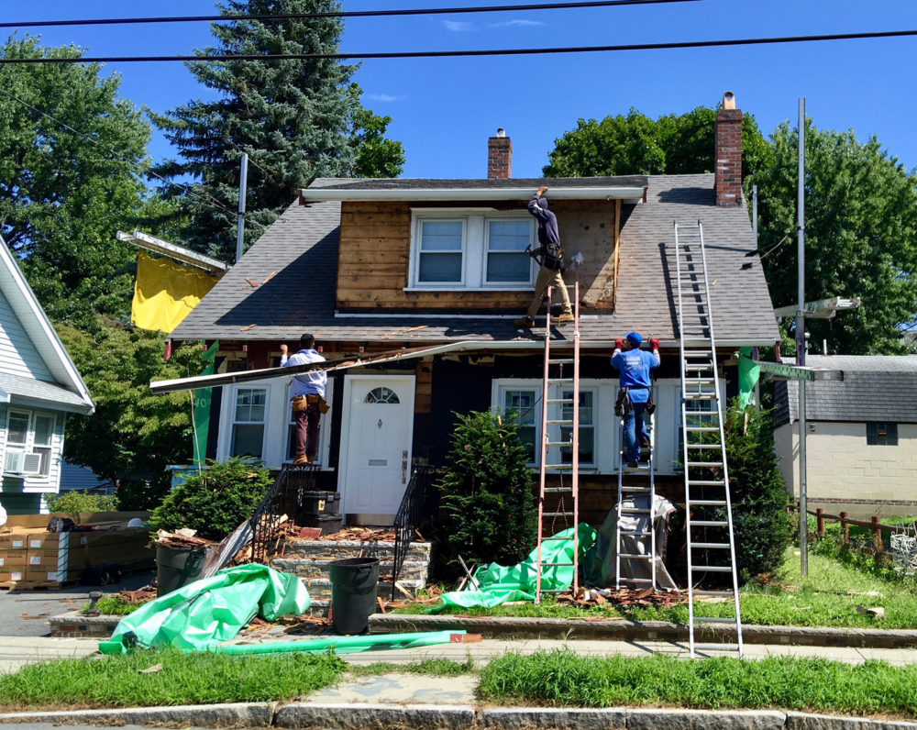
It’s the promise of EcoMakeover!
No money down, No hassle,
No risk!
It’s too good to be true! Let’s sign up!

Slide 4
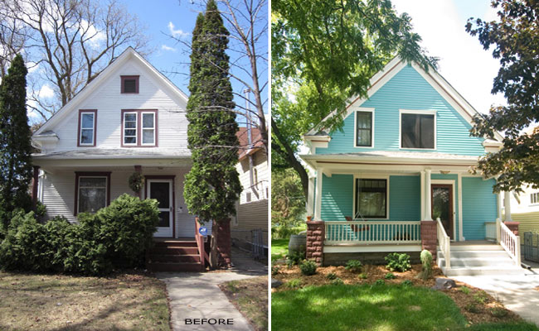
How does it work? Where’s the magic sauce?
Retrofitting makes homes 50% more energy & water efficient!
Block-scale solar microgrid + smart controls adds an extra 30% energy efficiency!
Provides enough energy to power one EV per house – no more need for dirty gasoline!
Wow, green tech is great!
It saves money & the planet too!

Slide 5
Business Model Canvas
Key Partners
Key Activities
Value Propositions
Customer Relationships
Customer Segments
Municipalities
Marketing
Improved home comfort
Marketing & outreach
Homeowner: middle-low income, metro
Community & Neighborhood Associations
Project Finance
Healthy indoor environment
Project delivery
Homeowner: higher-income, metro
Design & Permit
Address deferred maintenance
System operation
Energy & Water Utilities
Construction & Interconnection
Customer referrals
New Appliances and Equipment
Homeowner: Tech-savvy
Investment Banks
O&M
Increased property value
Homeowner: Eco-conscious
Key Resources
Channels
Municipality
Neighborhood Org
Community non-profits
Utilities
CCA
Contractors
New sidewalks
Landlord
Design/ engineering
Better street lighting
Equip. suppliers
Reduce hsehold energy + water costs
Housing data
Cost Structure
Revenue Streams
Customer Acquisition
Permits
Financing revenue
Project development & mgt.
O&M commission
General Contractor & Subs

Slide 6
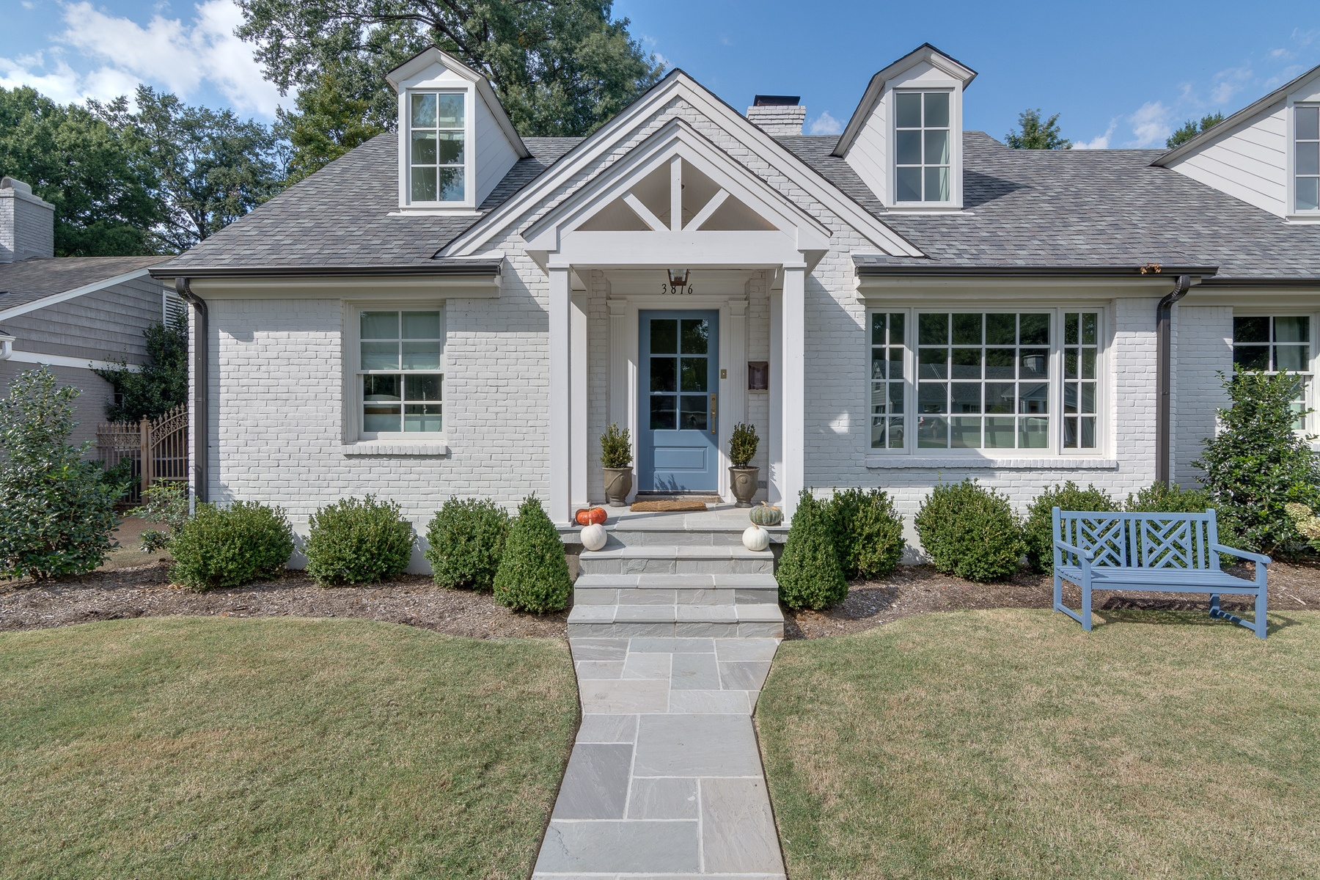
Homeowner Value Propositions
Maintenance brought
up to date
Insulated and sealed for comfort
Healthy indoor environment
Improved safety
New appliances and equipment
Energy independent from utility
Near-zero energy and water bills offset loan payment
Convenience of smart-home tech
Beautified landscaping
Disaster resilient and energy reliable
Eliminate waste of energy & water
Increased property value
Notes:
To date,
6

Slide 7
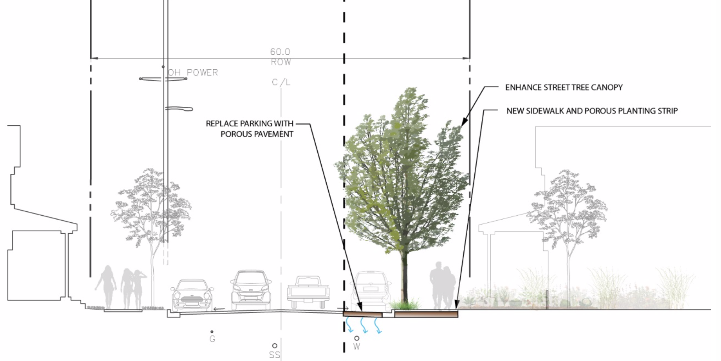
Neighborhood Value Propositions
Better lighting with LED streetlights
Rejuvenated landscaping
Improved public safety (e.g. security cameras?)
Strengthen neighborhood: turn utility and gas bills into inward investment
Improved traffic safety (e.g., traffic calming?)
New sidewalks
Affordable mobility and Improved parking with shared EVs and E-Bikes
Resilient undergrounded power system
Reduced flooding with porous pavement and rain gardens
7
Notes:
To date,
7

Slide 8
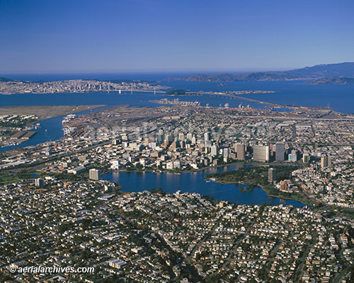
City/Regional Value Propositions
Meet decarbonization goals
Improved air quality
Drives inward investment and green jobs
Shared prosperity
The city “greens”
Affordably Improving Peoples’ Homes, Neighborhoods, and Cities for a Better Quality of Life, with no out-of-pocket cost and no net increase in monthly budget
8
Notes:
To date,
8

Slide 9
EcoMakeover Project Ecosystem and Life-Cycle
Insurance
City
Accounting & Billing
Build
Community Organizations
Develop Project
Develop Customers
Operate
EcoMakeover
Project
Developer
E-fleet Provider
Neighborhood Associations
O&M Service Provider
EcoMakeover Coop
Finance & Legal
Utility & Gov’t. Incentive Programs
Energy Utility (Interconnect)
General Contractor & Subs
Architects & Engineers
City (Permits & Public Works)

Slide 10
EcoMakeover Customer Relationships
Grow: Positive Referrals
Provide Ongoing Service
Market & Outreach with City and Local Partners
Build
Energy Reports & Billing
Develop Project
Develop Customers
Operate
EcoMakeover
Project
Developer
E-mobility Usage
Get
Organize EcoMakeover Coop
EcoMakeover Dashboard
Keep
Design & Finance Affordable Project with Desirable Features
Deliver Quality Product and Customer Experience

Slide 11
Enabling Partners
Partners | Benefits
 | For Us | For Them
Investment Banks | Cheapest financing | Low-risk, green investment
Municipality | Marketing assistance Favorable policies and permitting | Improve housing stock & neighborhoods Economic development
Community & Neighborhood Organizations | Marketing assistance | Improve neighborhoods Economic development
Energy & Water Utility | Data Grid interconnection with favorable tariff Investment incentives | Increase distributed energy assets through rate-base Grid reliability Retain customers

Slide 12
Biggest Takeaways
Not fundamentally an energy and water efficiency project
It’s a housing makeover that redirects utility bill savings and leverages value of homes into neighborhood improvements
Homeowner value proposition driven by quality-of-life issues such as comfort and healthy home
Neighborhood, city, global benefits are too abstract to motivate major homeowner investment
EcoMakeover market does not currently exist, we have to create it

Slide 13
Revenue Model
EcoMakeover is a Project Developer that organizes and finances neighborhood transformation
Project Revenue for one block:
Bond financing raised = $5M (gross revenue)
Estimated Gross Profit (25-40%) = $1.25-2M (after development and construction costs)
Estimated Net Profit (3-5%) = $150k-$250k (after marketing, administrative, and finance costs)
Profit ~ $200,000/block
Ongoing O&M: % commission on monthly O+M fee

Slide 14
Competition and Available Market
Competition: no equivalent product
Whole-home energy improvement (weatherization)
Single-system upgrade (furnace replacement)
Total Available Market: 3500 blocks in Oakland; $17.5B revenue
Serviceable Available Market: 1000 blocks in Oakland; $5B revenue
Serviceable Obtainable Market: 50 blocks in Oakland; $250M revenue (growth target for 5 years)

Slide 15
Customer Discovery – Top Interviews
City of Boulder, Climate Initiative Director – City struggling with how to pay for electrifying homes
CA Deputy Treasurer, Public Finance – Need to align state and local interests in infrastructure financing
Remodeling Contractor – 5 reasons homeowners do remodeling projects
Community Organizer – Economic development and displacement issues in neighborhoods
Non-profit founder, residential energy retrofits – Program patterned after Victory Gardens of WWII

Slide 16
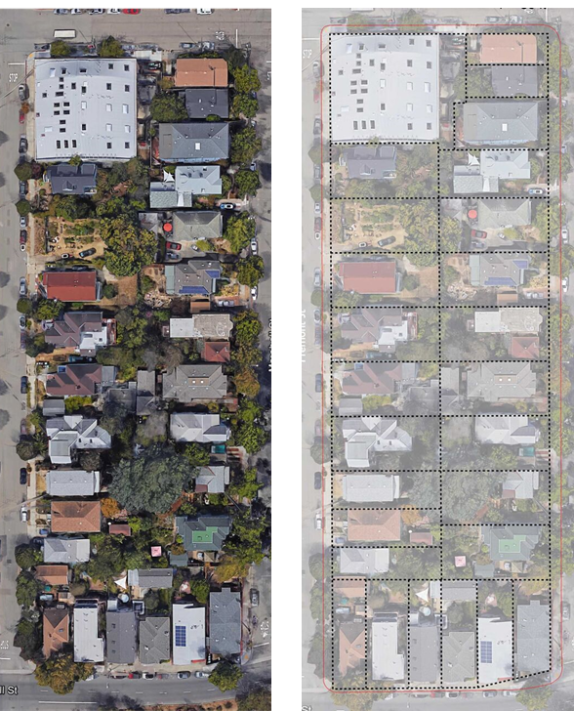
What’s Next for EcoBlock
Oakland pilot project
2/3 of funding raised
break ground in late 2020
validate performance and homeowner behavior
collect data on value propositions
Identify policy, permitting, utility tariffs, etc. needed for scaling
Work with local non-profits and community groups to partner on future blocks
Form non-profit
Objective: scaling with private market financing

